Slide 1
CAPSTONE PROJECT
DATA SCIENCE PROJECT
Presented By:
1. Subbitchana M-AC Tech,Anna University-Apparel Technology

Slide 2
OUTLINE
Problem Statement
Proposed System/Solution
System Development Approach
Algorithm & Deployment
Result
Conclusion
Future Scope

Slide 3
PROBLEM STATEMENT
PYTHON PROGRAM FOR FLIGHT TICKET RESERVATION SYSTEM

Slide 4
PROPOSED SOLUTION
Booking and Reservation Handling: Developing functionality to handle the booking process securely, including reserving seats, collecting passenger information, processing payments, and issuing tickets. Implementing features like seat selection and fare rules validation may also be necessary.
Payment Integration: Integrating with payment gateways to securely process transactions and accept various forms of payment, such as credit/debit cards, PayPal, or other electronic payment methods.
Ticketing and Confirmation: Generating electronic tickets and sending confirmation emails to customers upon successful booking. This involves generating unique booking references, managing ticket lifecycles, and sending notifications for changes or cancellations.
Customer Management: Implementing features for customers to vietheir booking history, manage upcoming flights, make changes or cancellations to existing bookings, and communicate with customer support if needed.

Slide 5
5.Security and Compliance: Ensuring the system complies with industry standards and regulations for data security and privacy, such as PCI DSS for handling payment information and GDPR for protecting personal data. 6.Error Handling and Exception Management: Implementing robust error handling mechanisms to gracefully handle unexpected scenarios, such as network errors, system failures, or invalid user inputs. 7.Performance Optimization: Optimizing the system's performance to handle a large number of concurrent users and process search and booking requests quickly and efficiently. This may involve caching frequently accessed data, optimizing database queries, and scaling infrastructure as needed.

Slide 6
SYSTEM APPROACH
1.Identify Stakeholders and Requirements: Understand the needs and expectations of stakeholders, including users (both customers and administrators), airlines, and regulatory authorities. Gather requirements through stakeholder interviews, surveys, and market research.
2. Search and Booking Workflow: Define the workflow for users to search for flights, select seats, provide passenger details, and make payments. Consider factors such as filtering options, seat availability, fare rules, and payment security.
3. Integration with External Systems: Establish integrations with external systems, such as airline reservation systems and payment gateways, to retrieve real-time flight data, manage inventory, and process bookings and payments securely.
4. Testing and Quality Assurance: Develop test cases to verify the functionality, performance, and security of the system. Conduct thorough testing, including unit testing, integration testing, and user acceptance testing, to identify and address any issues or bugs
5. Deployment and Maintenance: Deploy the system to production environments and monitor its performance and stability. Provide ongoing maintenance and support, including bug fixes, security updates, and feature enhancements, to ensure the system meets the evolving needs of its users.

Slide 7
ALGORITHM
User Input and Validation:
Prompt the user to enter details such as departure and arrival locations, departure date, number of passengers, etc.
Validate user input to ensure it meets the required format and criteria.
Search for Available Flights:
Query a database or an external API to retrieve available flight options based on the user's input criteria.
Filter the results based on factors such as departure/arrival times, airlines, prices, and available seats.
Display Search Results:
Present the user with a list of available flights, including relevant details such as flight numbers, departure/arrival times, durations, and prices.
Allow the user to select a flight from the list.
Seat Selection and Passenger Information:
If the user selects a flight, prompt them to choose seats and provide passenger information (names, contact details, etc.).
Validate the selected seats and passenger details.

Slide 8
5.Booking Confirmation and Payment: Generate a booking reference or confirmation code for the selected flight and passengers. Calculate the total price based on the selected seats and any additional fees. Integrate with a payment gateway to process the payment securely. Upon successful payment, confirm the booking and provide the user with a booking confirmation. 6.Error Handling and Exception Management: Implement error handling mechanisms to handle exceptions gracefully, such as invalid user input, payment failures, or system errors. Provide informative error messages and prompts to guide the user through the booking process.

Slide 9
.
DEPLOYMENT
Setup Development Environment:
Install Python and any required libraries or frameworks for developing the flight ticket booking system.
Choose a development environment such as a local IDE or code editor.
Database Setup:
Set up a database to store flight information, user data, booking records, etc.
Choose a suitable database management system (e.g., MySQL, PostgreSQL) and create the necessary tables and indexes.
Code Development:
Develop the flight ticket booking system using Python, following the algorithm outlined above.
Test the code thoroughly to ensure it works as expected and handles various scenarios.
Integration with External Services:
Integrate the booking system with external services such as airline APIs for retrieving flight information and payment gateways for processing payments.
Obtain API keys or credentials for accessing external services securely.

Slide 10
5.Deployment to Production Environment: Choose a hosting provider or server for deploying the flight ticket booking system. Configure the server environment and install any required dependencies. Deploy the Python code and database to the production server. 6.Security and Monitoring: Implement security measures such as HTTPS encryption, input validation, and access controls to protect user data and prevent security vulnerabilities. Set up monitoring tools to monitor system performance, detect errors, and track user interactions. 7.Continuous Improvement: Collect feedback from users and stakeholders to identify areas for improvement. Iterate on the codebase to fix bugs, add new features, and optimize performance based on user feedback and usage metrics.

Slide 11
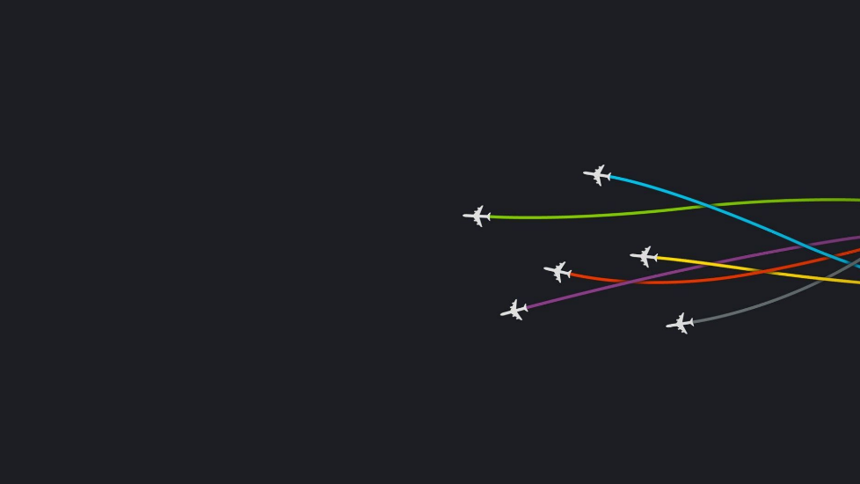
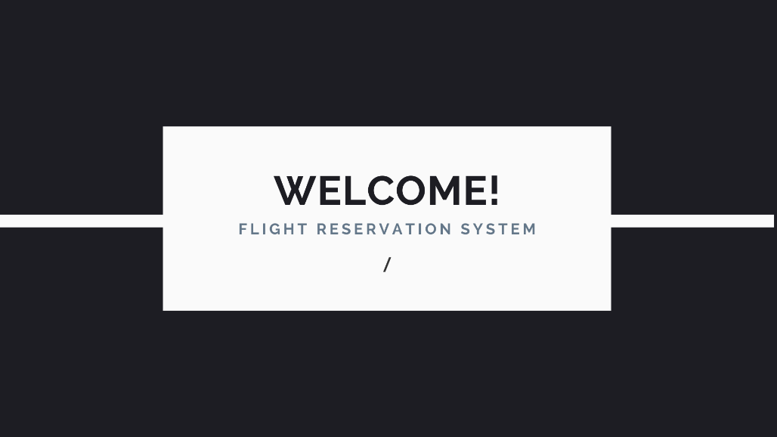

RESULT

Slide 12
CONCLUSION
Algorithm Design: Design an algorithm that efficiently handles user input, searches for available flights, manages seat selection and passenger information, and confirms bookings securely. Implement error handling mechanisms to gracefully handle exceptions and guide users through the booking process.
Code Development: Develop the flight ticket booking system using Python, leveraging appropriate libraries and frameworks to streamline development. Test the code rigorously to ensure it works as expected and meets the specified requirements.
Deployment: Deploy the booking system to a production environment, configuring the server environment, integrating with external services, and implementing security measures to protect user data and ensure system reliability. Monitor the system for performance issues, errors, and security vulnerabilities.
User Experience: Focus on providing a seamless and intuitive user experience, with clear navigation, informative feedback, and responsive design across different devices and screen sizes. Continuously collect feedback from users and stakeholders to identify areas for improvement and iterate on the system accordingly.

Slide 13
.
5.Security and Compliance: Implement security measures such as encryption, input validation, and access controls to protect user data and prevent security vulnerabilities. Ensure compliance with industry regulations such as GDPR and PCI DSS for handling sensitive information securely.
6.Continuous Improvement: Continuously improve the system based on user feedback, usage metrics, and emerging technologies. Iterate on the codebase to fix bugs, add new features, and optimize performance to meet the evolving needs of users and stakeholders

Slide 14
FUTURE SCOPE
Integration with Emerging Technologies: Explore integration with emerging technologies such as artificial intelligence (AI) and machine learning (ML) to enhance the user experience and optimize various aspects of the booking process. For example, AI-powered chatbots can provide personalized assistance to users, while ML algorithms can analyze booking patterns to offer targeted recommendations and optimize pricing strategies.
Enhanced Personalization: Implement advanced personalization features that tailor the booking experience to individual user preferences and behavior. This may include offering customized recommendations based on past bookings, travel history, and demographic information, as well as providing targeted promotions and loyalty rewards to incentivize repeat bookings.
Mobile Optimization: With the increasing prevalence of mobile devices, focus on optimizing the flight ticket reservation system for mobile platforms to cater to the growing number of users who prefer to book flights on their smartphones and tablets. Develop native mobile apps or responsive web interfaces that provide a seamless and intuitive booking experience across a wide range of devices and screen sizes.

Slide 15
.
3.Augmented Reality (AR) and Virtual Reality (VR): Experiment with AR and VR technologies to offer immersive booking experiences that allow users to visualize and interact with flight options in a virtual environment. For example, users could use AR to view 3D seat maps and select their preferred seats, or VR to take virtual tours of aircraft cabins before making a booking decision.
4.Data Analytics and Predictive Modeling: Harness the power of data analytics and predictive modeling to gain insights into customer behavior, market trends, and demand patterns. Use advanced analytics techniques to analyze booking data, forecast future demand, and optimize inventory management, pricing strategies, and route planning to maximize revenue and efficiency.
5.Voice-Activated Interfaces: Explore the integration of voice-activated interfaces such as voice assistants and voice recognition technology to enable hands-free booking experiences. Develop voice-enabled features that allow users to search for flights, make bookings, and manage reservations using natural language commands, providing greater convenience and accessibility for users

Slide 16
THANK YOU

